Slide 1
Want to be a millionaire?
Group 5
Yidi Wu
Iulian Toma
Ji Nan

Slide 2
Intro
Interface
Class diagram
How to play the game

Slide 3
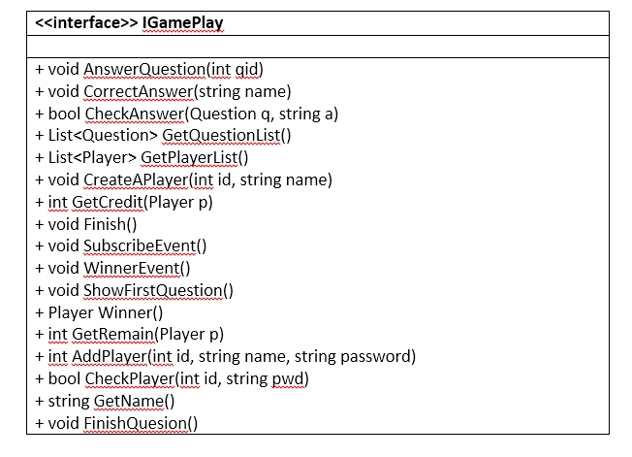
Interface for Game

Slide 4
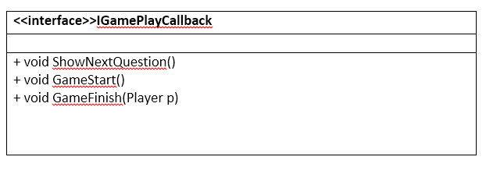
Interface for Callback

Slide 5
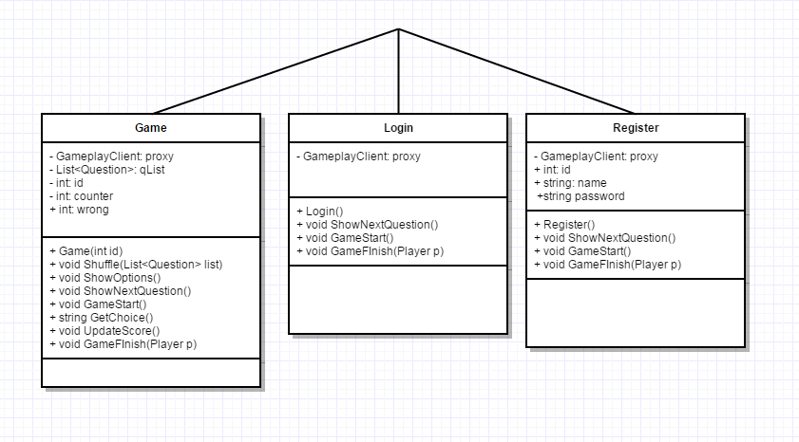
Class diagram: Client

Slide 6
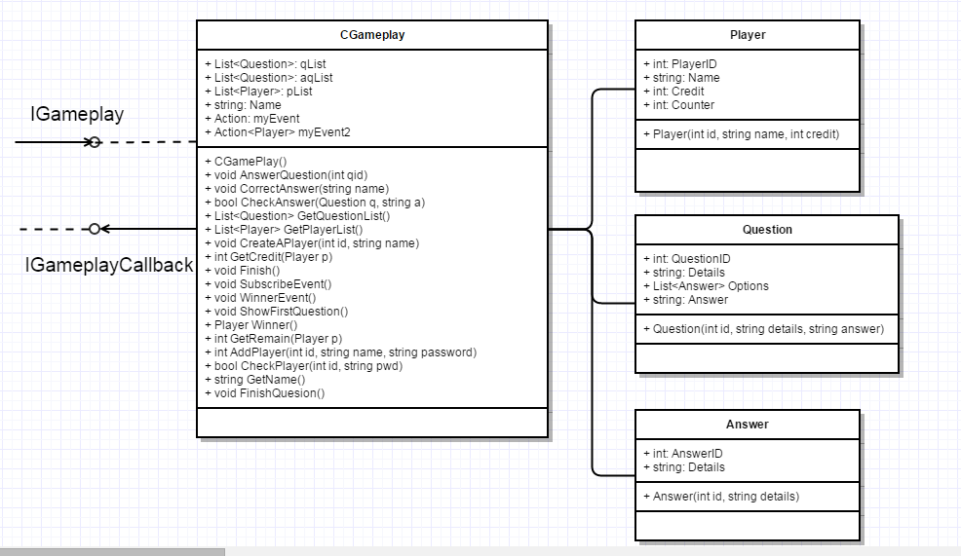
Class diagram: Server

Slide 7
The Game
Register
No
Registered?
Yes
Game
Login

Slide 8
The End &
Thank you!

